Slide 1
Today
1st … what’s in store for the coming weeks
Then …
Review of equations for prognostic variables
Using PropagateClimateState to model Earth’s climate over time
Diagnostic variables (Tier 1, Tier 2)
Inspecting the results of a Cambio2.0 run (including temperature!)

Slide 2
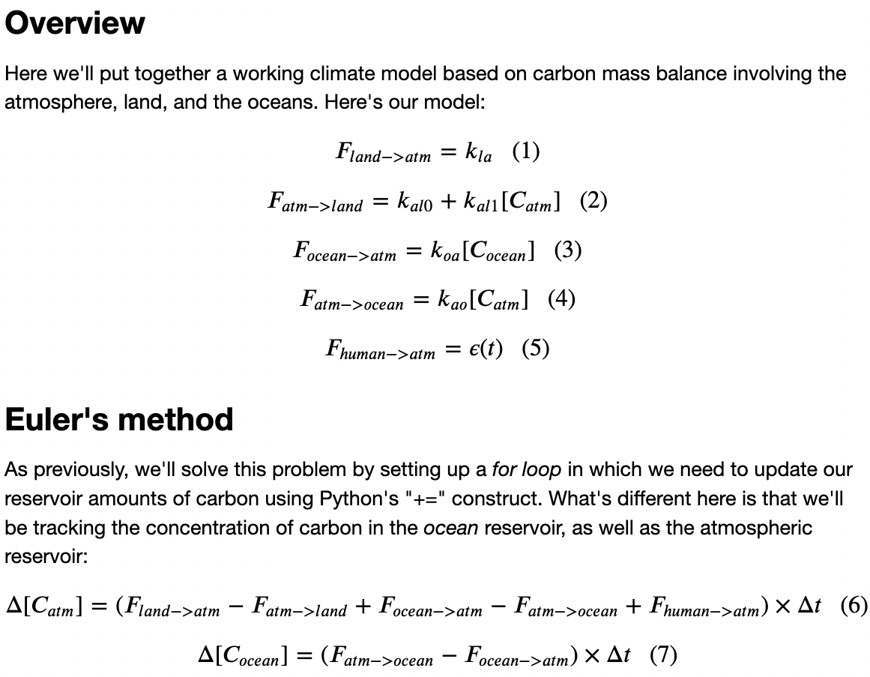
Equations for prognostic variables

Slide 3
Today
Review of equations for prognostic variables
Using PropagateClimateState to model Earth’s climate over time
Diagnostic variables (Tier 1, Tier 2)
Inspecting the results of a Cambio2.0 run (including temperature!)

Slide 4
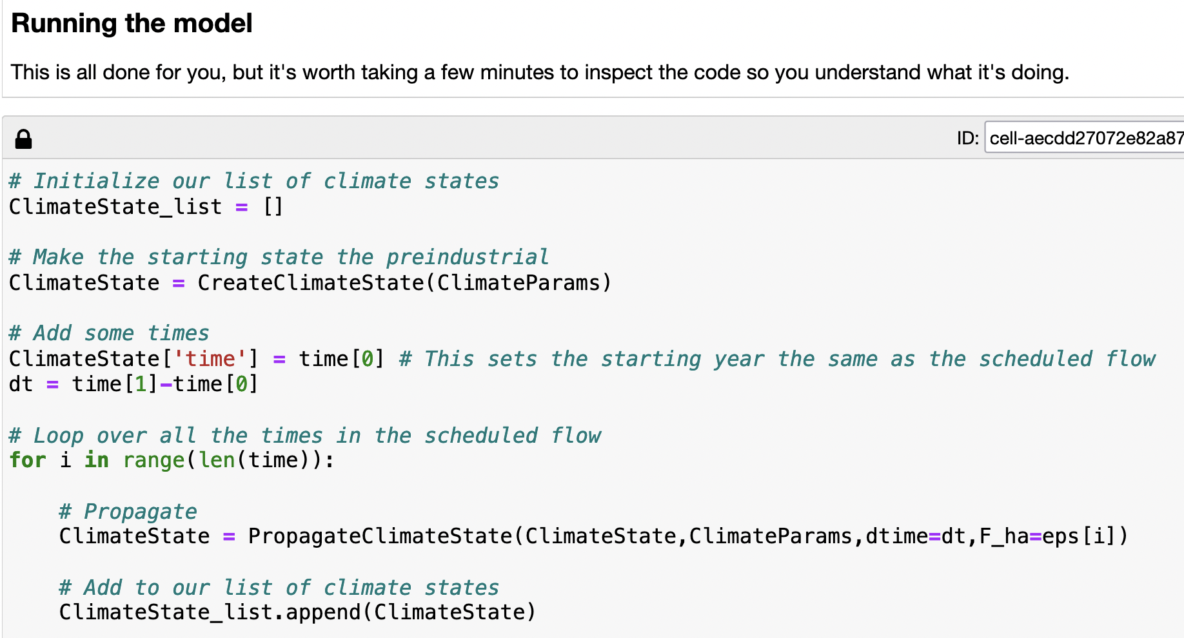
Using PropagateClimateState to model Earth’s climate over time

Slide 5
Using PropagateClimateState to model Earth’s climate over time
We create the starting climate state

Slide 6
Using PropagateClimateState to model Earth’s climate over time
The starting climate state is given as input to the climate propagator

Slide 7
Using PropagateClimateState to model Earth’s climate over time
The climate propagator predicts a new climate state after time dt

Slide 8
Using PropagateClimateState to model Earth’s climate over time
The new climate state is appended to the list of climate states

Slide 9
Using PropagateClimateState to model Earth’s climate over time
The new climate state is also passed on to the propagator to make the next climate state

Slide 10
Using PropagateClimateState to model Earth’s climate over time

Slide 11
Today
Review of equations for prognostic variables
Using PropagateClimateState to model Earth’s climate over time
Diagnostic variables (Tier 1, Tier 2)
Inspecting the results of a Cambio2.0 run (including temperature!)

Slide 12
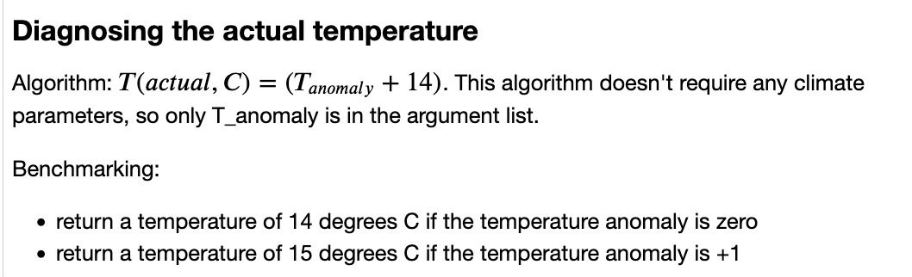
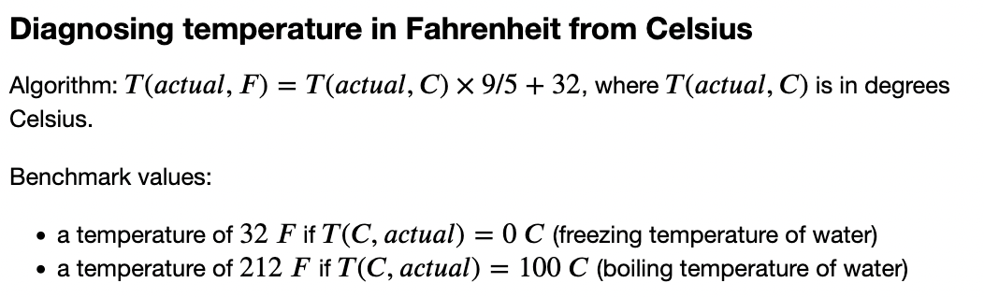
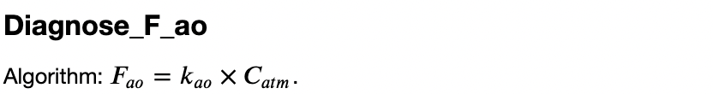
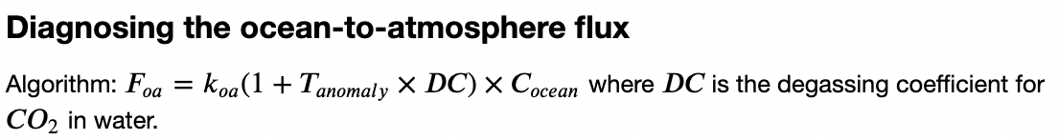
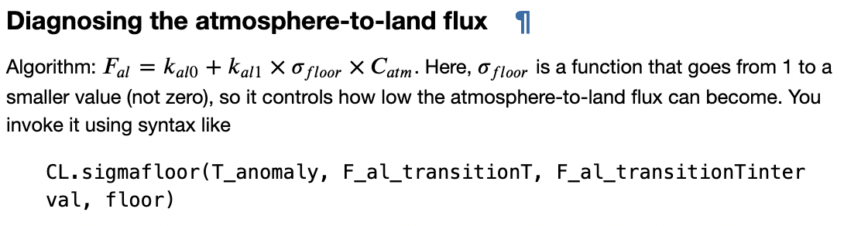
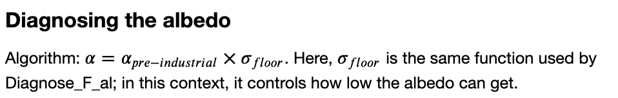
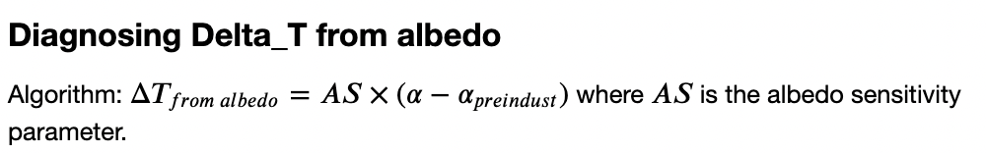
Diagnostic variables – these are the ones we talked about last time

Slide 13
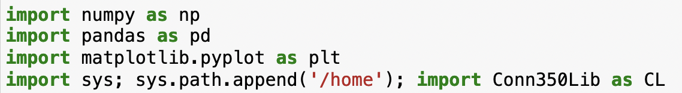
Diagnostic variables – in Cambio2.0, we’ve moved all of them into Conn3450Lib

Slide 14
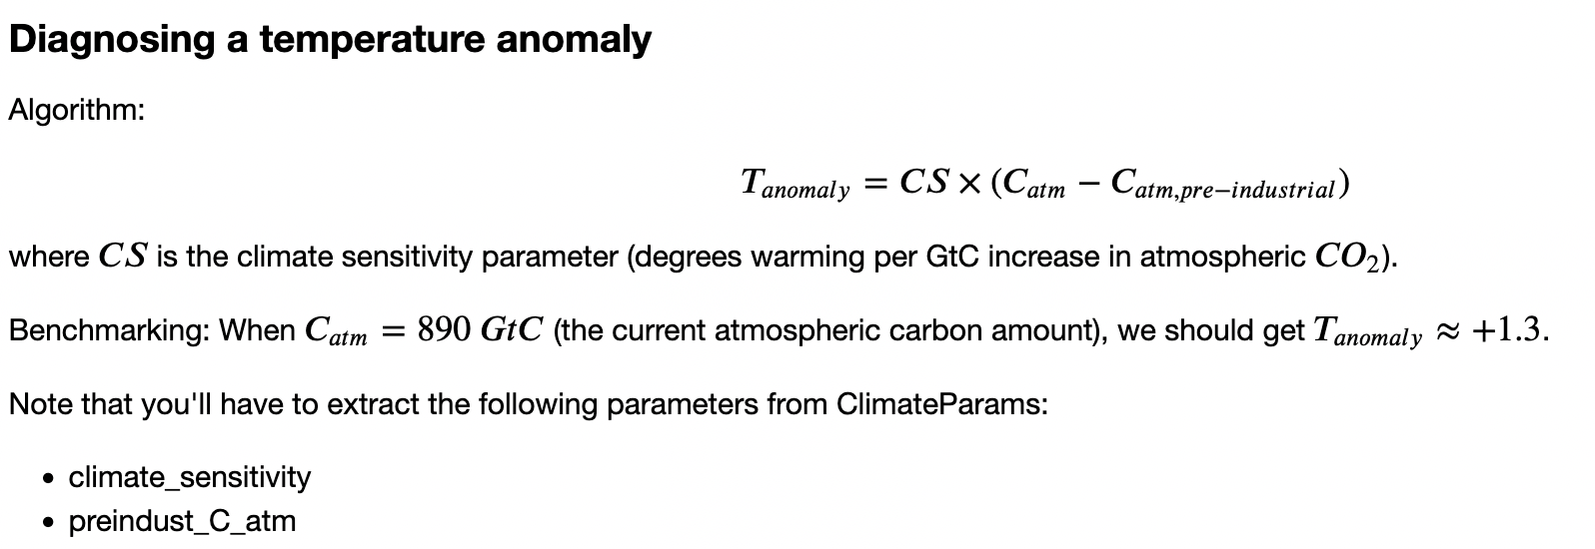
Diagnostic variables – In particular, Diagnose_T_anomaly calculates the temperature anomaly
CS = slope of this line

Slide 15
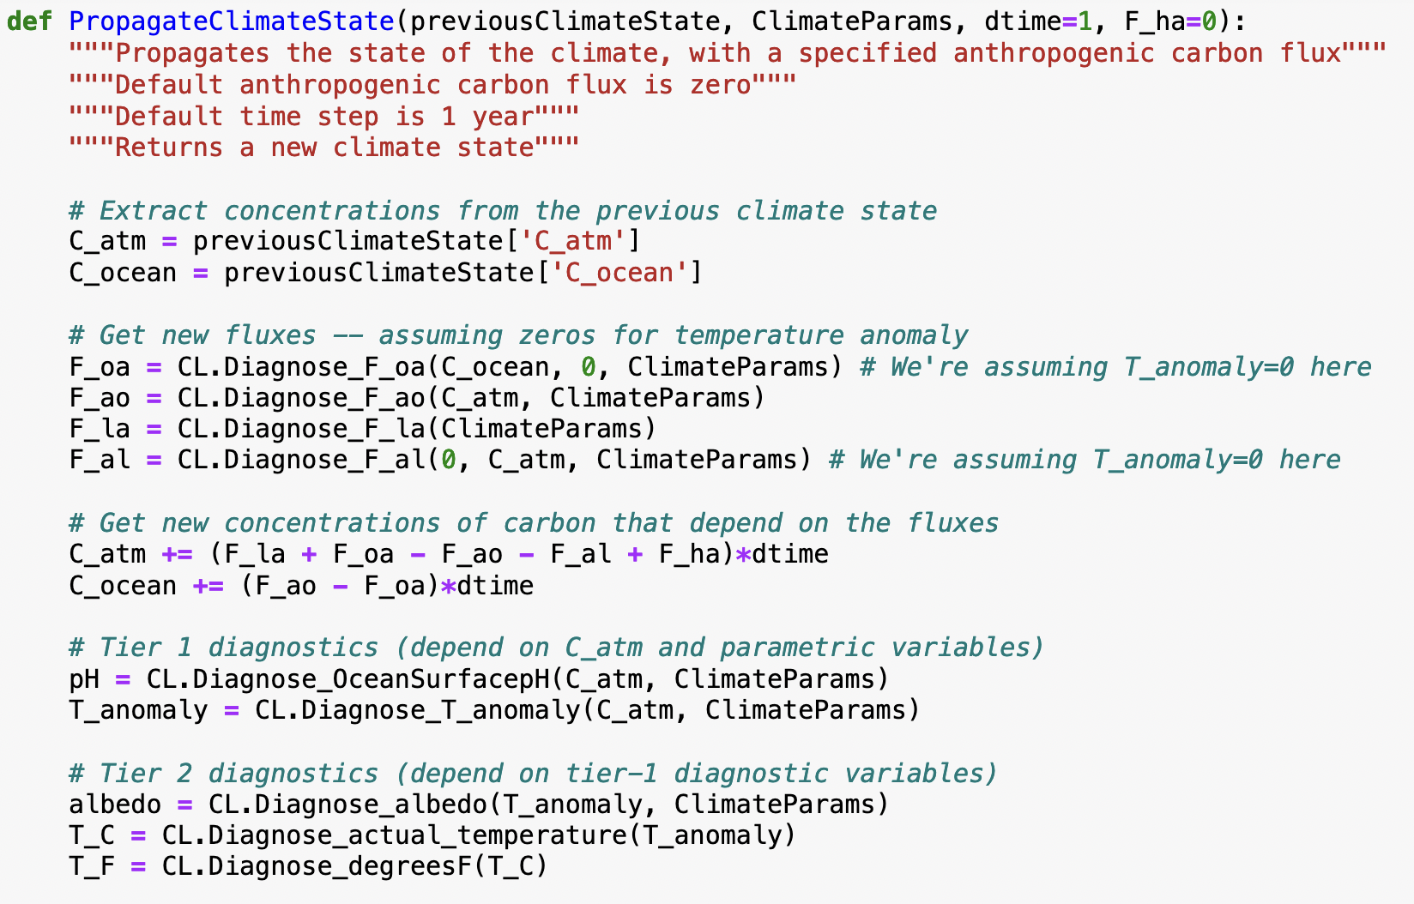
Diagnostic variables – pH and T_anomaly are “Tier 1” diagnostics b/c they come from C_atm

Slide 16
Diagnostic variables – albedo, T_C, and T_F are “Tier 2” b/c they come from T_anomaly

Slide 17
Today
Review of equations for prognostic variables
Using PropagateClimateState to model Earth’s climate over time
Diagnostic variables (Tier 1, Tier 2)
Inspecting the results of a Cambio2.0 run (including temperature!)

Slide 18
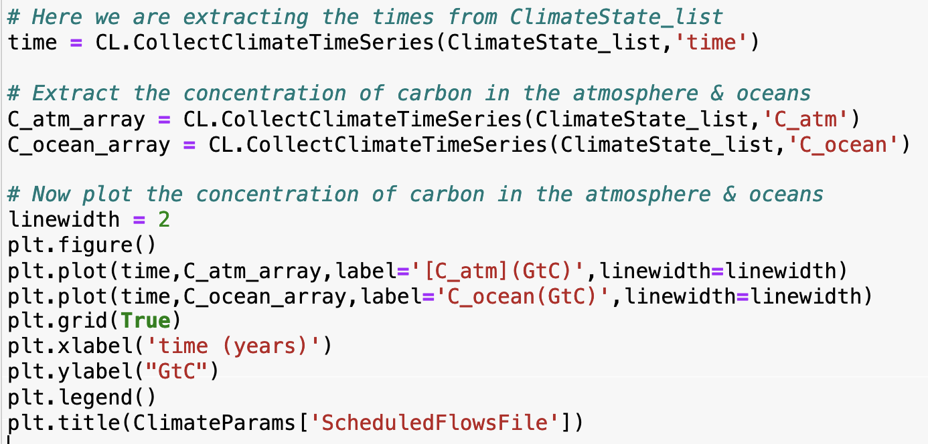
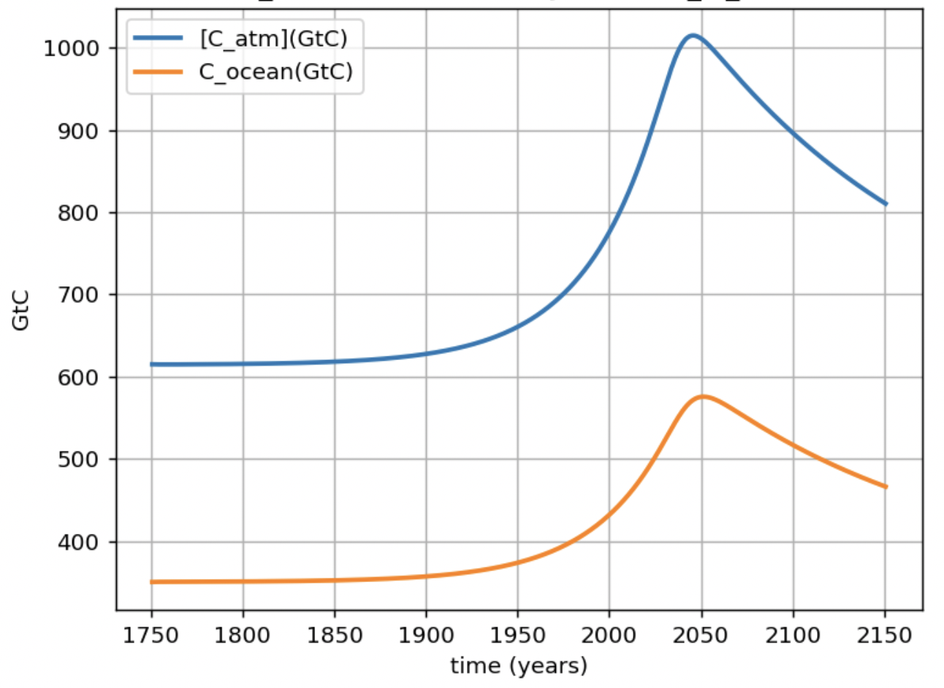
Inspecting the results of a Cambio2.0 run – Amounts of carbon in the atmosphere and ocean

Slide 19
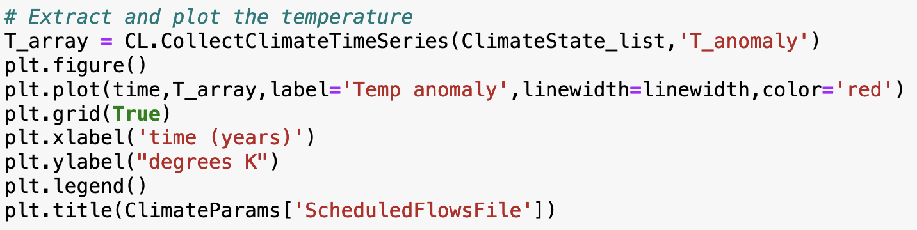
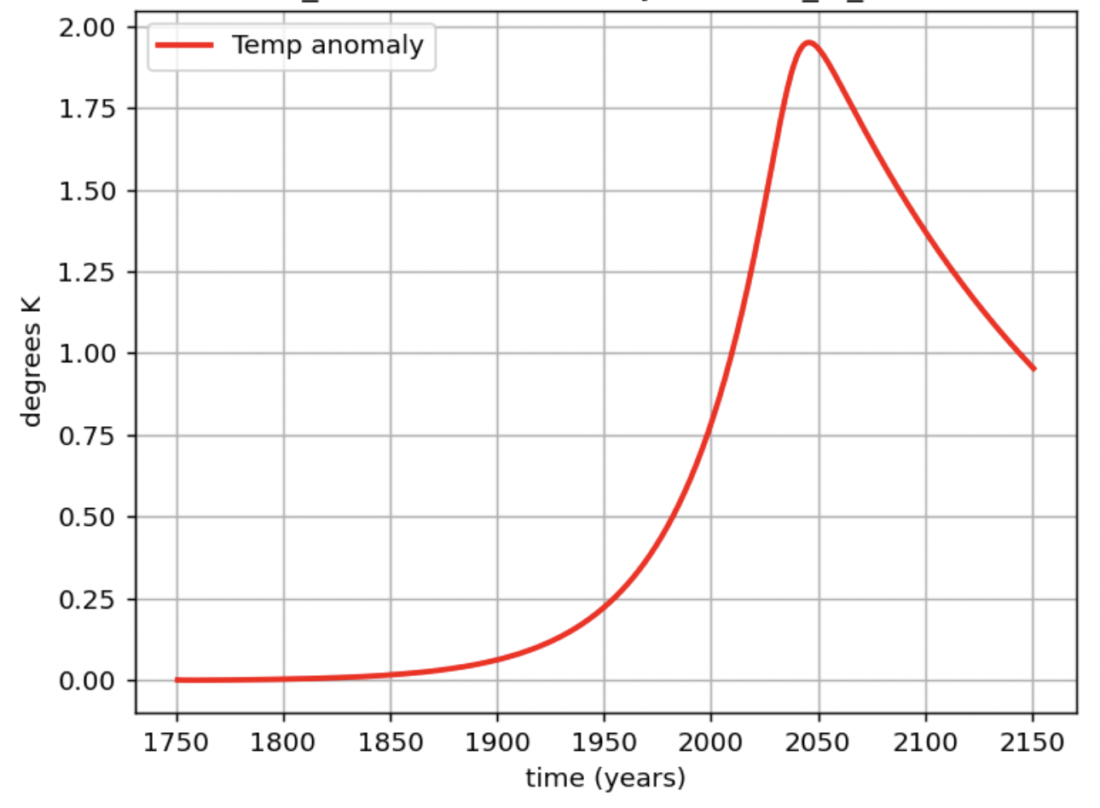
Inspecting the results of a Cambio2.0 run – For the first time … global temperature anomaly

